Slide 1

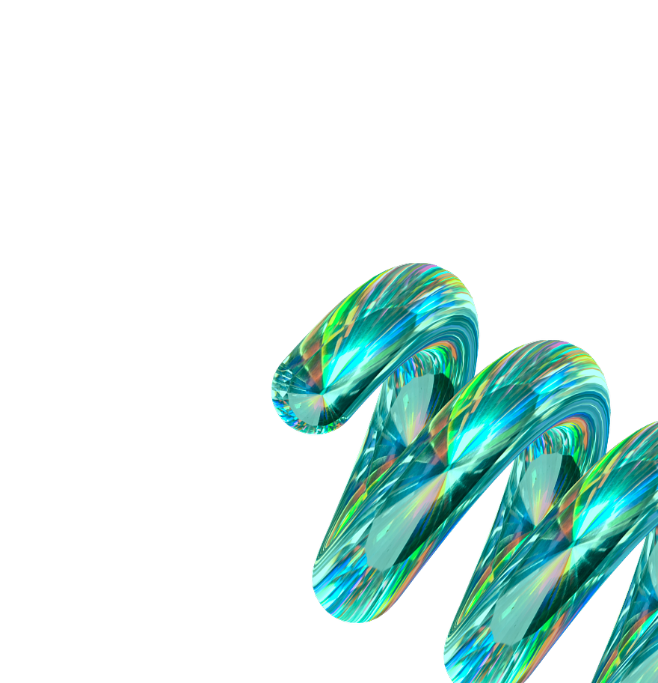

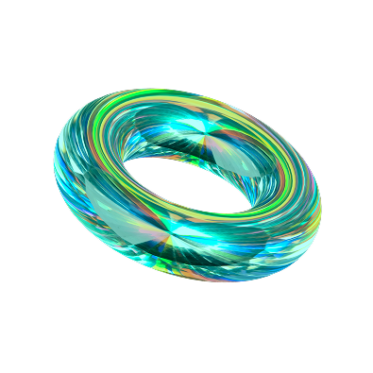


Foundations of
Human Centered
Data Science

Slide 2









Learning Outcomes
Describing Data Science Lifecycle
Locate Human TouchPoints
Explain Abstraction Traps
Describe Harm Beyond Accuracy
Notes:
Add abstraction traps + harm beyond accuracy

Slide 3



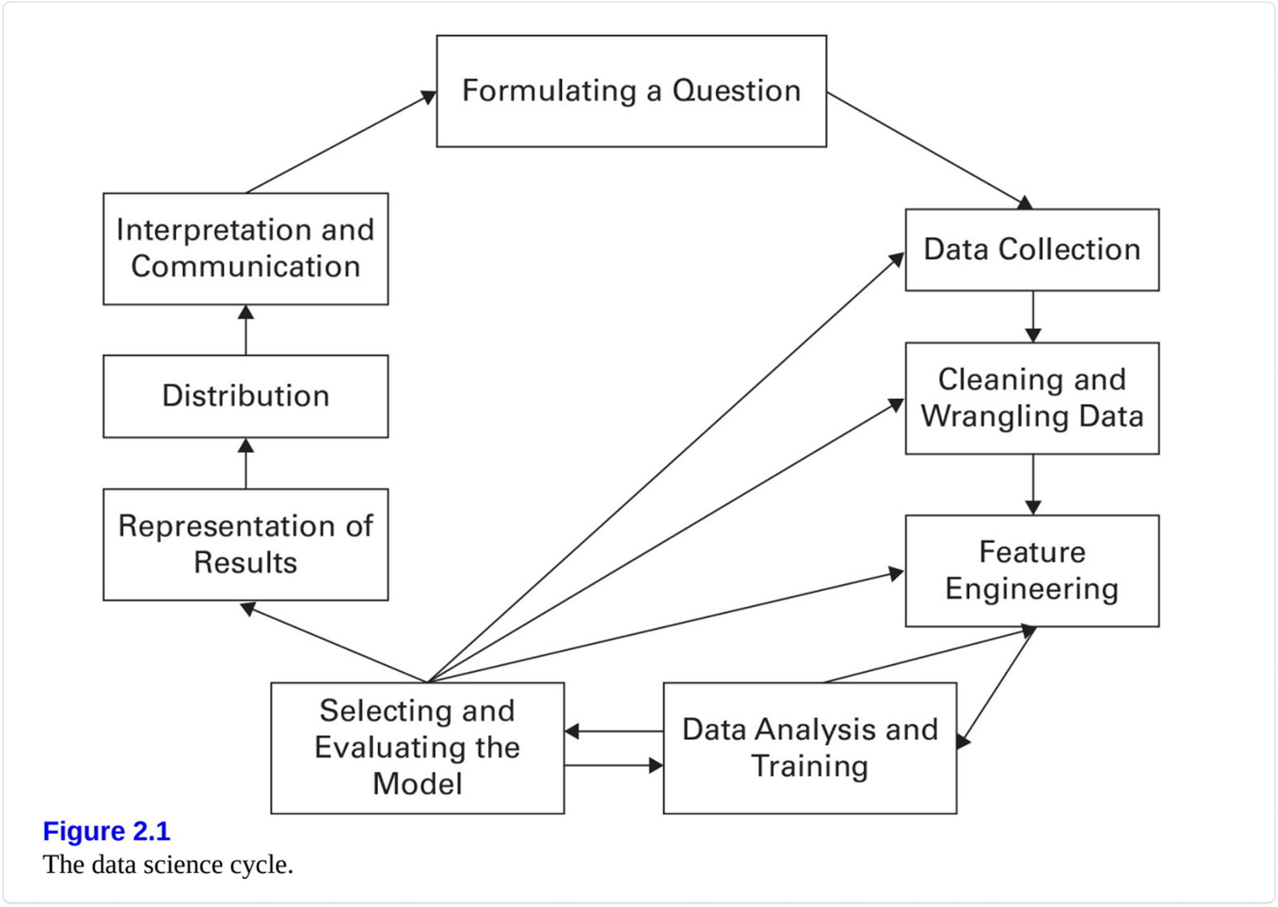






Notes:
Leave comment.

Slide 4
Formulating a Question:
Input
Goal
Output
Research a problem or real-world question
Formulate a meaningful and specific question that you will use the data science process to answer
Well-scoped question that will guide the data science life cycle
Risks
Letting the data lead the question
Path of least resistance, rely on easily available data
Bias or skewed conclusions from limitations of current data

Slide 5
Data Collection:
Input
Goal
Output
Research Question
Candidate datasets and their metadata
Determine the most appropriate data set to answer the research question, how that data will be collected, understand strengths and weaknesses of this data.
Selected dataset or data collection plan.
Clear reasoning for why this data, what is, will be collected and how, who is represented in the data.
Risks
Biased data or collection
Misuse of existing data
Ethical concerns

Slide 6
Cleaning & Wrangling Data
Input
Goal
Output
Raw data set selected to answer the research question
Prepare data for analysis and getting to know your data
Cleaned and documented data set
Understanding of missing values and outliers
Who/what is in the data
Risks
Loss of important information
Bias introduction
Over-cleaning

Slide 7
Feature Engineering
Input
Goal
Goal
Output
Output
Cleaned data set
Transformed feature space and a set of representational choices (through abstraction).
Selecting variables in the dataset to include in the model, as well as producing combined features to capture additional aspects of the dataset.
Risks
Some information is easier to represent as variables than others
Important to think about what information is left out

Slide 8
Data Analysis & Training
Input
Goal
Output
Prepared data set
Fitted model parameters, candidate models, and/or learned decision boundaries
Determine which data will be used for training your model, recognizing if the training data is labeled or not.
Risks
Incorrect or unlabeled data
Bias in training data
Insufficient training data
Notes:
Prior output: Clean data that can be used to run different models
Gaining a strong understanding of your data

Slide 9
Selecting & Evaluating Model
Input
Goal
Output
Prepared data set.
Training/test data.
Trained model.
Quantitative measures of model performance.
Selecting the best model to analyze the data and produces accurate and reliable predictions.
Risks
Overfitting
Missing data

Slide 10
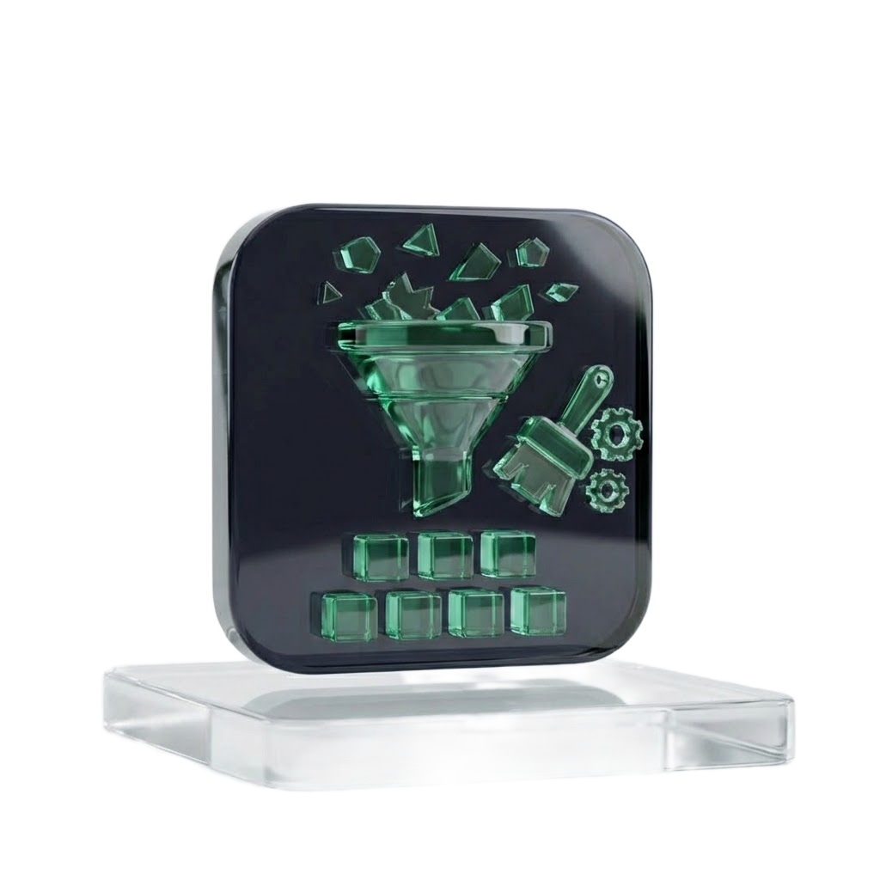
Activity 1
Take a look at the data on the next slide:
Clean the messy data how you see fit
Discuss how you cleaned it and why you made those choices
Through this cleaning process:
What information was lost?
What information was standardized?
What information was made invisible through cleaning choices?

Slide 11
Student_ID | Name | Age | Score | Enrollment_Date
101 | John Smith | 20 | 88 | 2023-09-01
102 | Maria Lopez | 19 | 92% | 09/02/2023
103 | Ahmed Khan | twenty | 76 | 2023-13-01
104 | Li Wei | 21 |  | 2023/09/03
106 | Sarah O’Neil | - | 85 | 2023-08-05
106 | David Kim | 22 yrs | ninety | 2023-09-06
108 | Emiliy Davis | 20 | 101 | Sept 8,2023
109 | Michael Brown | 200 | 67 | 2023-09-09
 | Jessica Wilson | 19 | 73 | 2023-09-10
111 | Chris Johnson | 18 | 45 | 2023-09-31
113 | Tom Lee | 20 | 78 | 12-09-2023
114 | Fatima Ali | 19 | 88.5 | 2023-08-14
115 | George Clark | N/A | 84
Notes:
Move bottom of slide 10 to new slide 12

Slide 12
Representation of Results
Input
Goal
Output
Results from prior stages of the data science life cycle
Interpretable information about the data and analysis done
Data visualization
Summary of key findings
Effectively communicate results of data analysis done
Risks
Over-simplification
Confirmation Bias

Slide 13
Distribution
Input
Goal
Output
Everything done to analyze your data
Comprehensive and reproducible documentation
Communicate the full data science process
The data used
Methods used to prepare the data
The analysis & results
Risks
Lack of transparency
Misinterpretation

Slide 14
Interpretation & Communication
Input
Goal
Output
Completed data science life cycle.
Clear communication of results and findings.
Interpret and communicate results clearly so other can understand, interpret, and reproduce the analysis.
Risks
Unintended downstream harms

Slide 15

Risks Review:
Analysis Risks:
Overfitting
Missing data
Biased data or collection
Misuse of existing data
Abstraction Traps
Ethical Risks:
Ethical concerns
Lack of transparency
Misinterpretation
Bias or skewed conclusions from limitations of current data
Investigative Risks:
Letting the data lead the question
Path of least resistance: relying on easily available data
Notes:
ADD ABSTRACTION TRAP

Slide 16
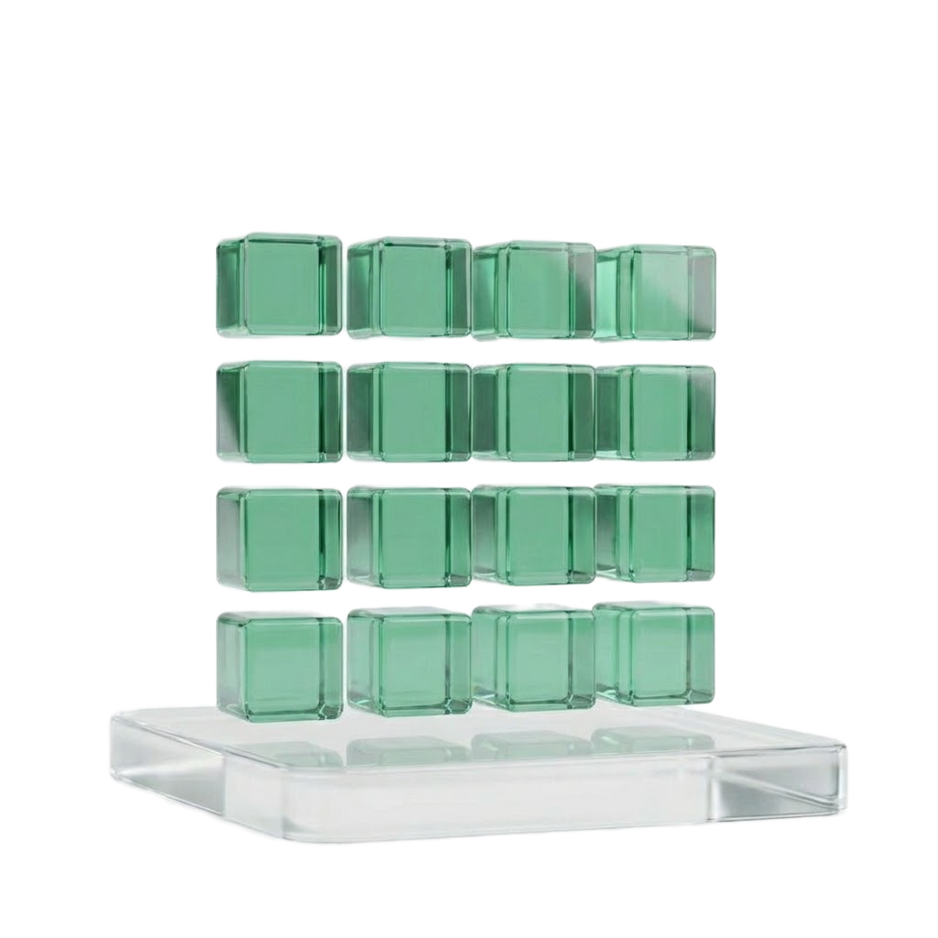
Activity 2
Here is a version of cleaned data from activity 1. What do you do now:
Back to the data source for more data?
Move forwards with modeling?
Discuss with stakeholders what you should do next?

Slide 17
Student_ID | Last Name | First Name | Age | Score (%) | Enrollment_Date (YYYY-MM-DD)
101 | Smith | John | 20 | 88 | 2023-09-01
102 | Lopez | Maria | 19 | 92 | 2023-09-02
104 | Wei | Li | 21 | 81.4 | 2023-09-03
106 | Kim | David | 22 | 90 | 2023-09-06
108 | Davis | Emily | 20 | 81.4 | 2023-09-08
111 | Johnson | Chris | 18 | 45 | 2023-09-31
112 | Muller | Anna | 21 | 82 | 2023-09-12
113 | Lee | Tom | 20 | 78 | 2023-09-12
114 | Ali | Fatima | 19 | 88.5 | 2023-09-14

Slide 18
Human Centered Data Science a Critical Lens
Reframing the Data Science Lifecycle Through a Human Lens
Notes:
Add a subheading: “applying a human centered lens to the data science lifecycle”

Slide 19
search
cloud_download
auto_awesome
category
label
1. Discovery
2. Capture
3. Curation
4. Design
5. Creation
Encountering a problem and crafting a question to investigate.
Searching for a dataset and acquiring it.
Editing and/or altering data for a certain purpose, or combining data from multiple sources.
Crafting and/or categorizing data through sets of choices.
Adding values to the records in a dataset through assigning or labeling those values.
Human-Centered Data Science Workflow
Notes:
Change colours + logos/symbols
The workflow is useful, but students will likely need clearer guidance on how these categories relate to the earlier lifecycle stages. It may help to visually map discovery/capture/curation/design/creation onto question formulation, collection, cleaning, feature engineering, modeling, and communication

Slide 20

Case Study: Practicing the data science life cycle
The problem: A city is studying their public transportation network. It is plagued by delays and overcrowding during rush hour. As they look at this problem community members worry that the solutions will not solve underlying issues such as lack of routes in certain communities and issues with accessibility.

Slide 21
Discovery: Crafting the question
search
When looking at this problem it is important to think about perspective and the question you want to ask:
Why is transit often delayed?
Who is transit delayed for most often?
Where and when is transit most often delayed?
It is important to continually consider who is represented in the question and who has been left out. Inherently, problem formulation is already a value-laden design decision and not a neutral first step.

Slide 22
Capture: Data Collection
cloud_download
What data already exists about this problem? How and why was this data collected? Who does this data serve?
Previous transit data has been gathered about commuters, looking only at rush hour use
Some studies have been conducted about neighborhood transit use but focused only on the downtown core (mostly high income neighborhoods)
Some data has been collected from social media looking at transit complaints
Which populations are systematically missing from complaint-based and commuter-centered data, and how that absence would distort the eventual intervention? What would it look like to collect new data and how might this data be different?

Slide 23
Curation & Design: Data Cleaning and Wrangling
auto_awesome
category
You now have the data set you are going to use but it is large and messy.
What choices will be made about how to clean the data, how might this change how the data is interpreted? How will we ensure that the community and their needs are represented in the data?
What choices were made about how to categorize data?
Whose voices and experiences are prioritized in the design of this dataset?

Slide 24
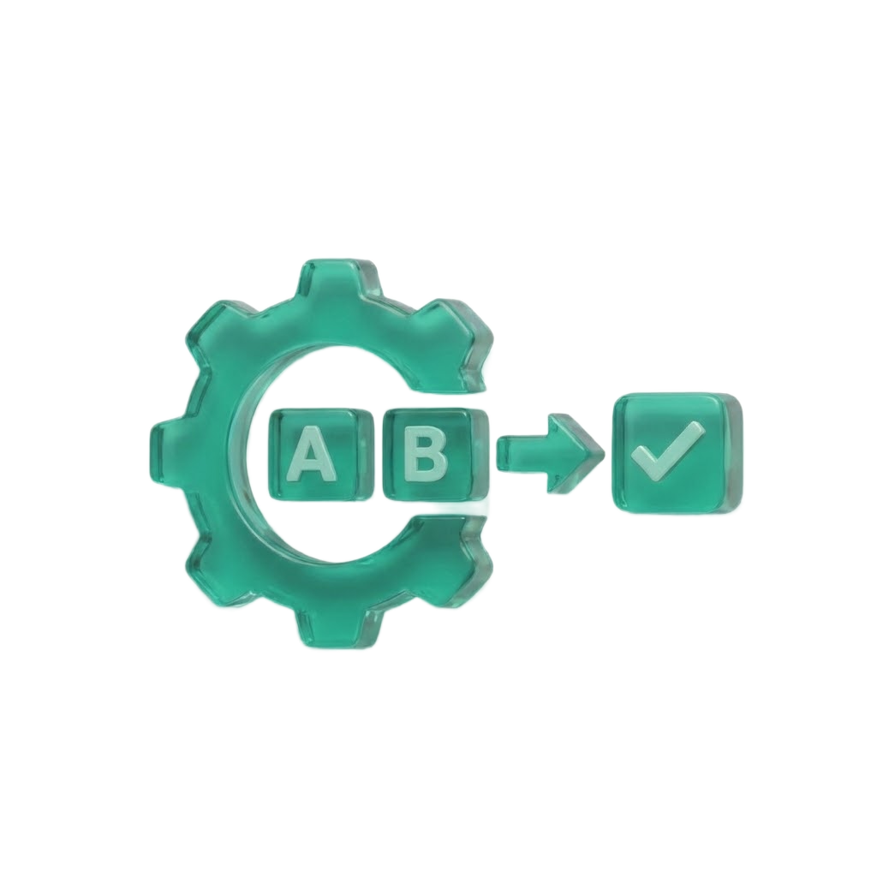
Creation: Feature Engineering
label
Now you need to determine which features should be in the data:
Which features in the data are important to the communities impacted?
What features represent the human experience of using public transit?
How can you represent this in the data?
Feature Engineering can lead to abstraction traps:
Not all lived experiences can be easily represented as features in data, forcing this translation into variables can erase context.
Notes:
abstraction traps

Slide 25
Model Choice, Evaluation & Downstream Consequences:
ctegory
Now you need to determine which model you will use to analyze the data, how you will evaluate the models performance, and what downstream consequences may result from your choices.
How will you select your model what information in the data leads you to this decision?
Evaluating your model can be done in many ways which measures of accuracy will you use, what trade-offs are you making by optomizing for specific accuracy?
How do these choices impact the individuals being served or not served by transit?

Slide 26
Activity 3: Group Exit Ticket
For each stage of the life cycle, brainstorm a real-life scenario and relevant:
Decision
Risk
Affected stakeholders
Human-centered mitigation
How would a human-centered strategy assist your decision-making at each stage?
Notes:
Time budget (20+ minutes), on the way ‘out the door’.
Debrief with students the following class by providing 2-3 examples.
Suggest collecting and sharing anonymized diagrams back to the class after each lecture for peer-to-peer learning. Instructor can assemble all group exit tickets at the conclusion of the semester as a student-generated debrief of the entire course.

Slide 27
Activity 3: Group Exit Ticket
Formulating Question | Data Collection | Cleaning/ Wrangling Data | Feature Engineering | Data Analysis/ Training | Selecting/ Evaluating Model | Representation of Results | Distribution | Interpreting/ Communicating
Decision
Risk
Stakeholders
Mitigation
How would a human-centered strategy assist your decision-making at each stage?

Slide 28
Credits and References
V. Stodden. 2020. The data science life cycle: a disciplined approach to advancing data science as a science. Communications of the ACM 63, 7 (July 2020), 58–66. https://doi.org/10.1145/3360646
D. Wang, J. Andres, J. D. Weisz, E. Oduor, and C. Dugan. 2021. AutoDS: Towards Human-Centered Automation of Data Science. In Proceedings of the 2021 CHI Conference on Human Factors in Computing Systems (CHI '21). Association for Computing Machinery, New York, NY, USA, Article 79, 1–12. https://doi.org/10.1145/3411764.3445526
M. Boenig-Liptsin, A. Tanweer, and A. Edmundson. 2022. Data Science Ethos Lifecycle: Interplay of Ethical Thinking and Data Science Practice. Journal of Statistics and Data Science Education 30, 3 (2022), 228–240. https://doi.org/10.1080/26939169.2022.2089411

